Slide 1

Bangladesh Army University of Engineering & Technology
Course Code: CSE-3110
Course Title: Web Programming Sessional
Topic:All Tour Spots in Bangladesh
Submitted by | Submitted to
Name: Md. Moneruzjaman Mone | Bristi Rani Roy
Gourob Roy , Mst. Bilkis khatun | Lecturer, Dept. of CSE , BAUET
Md. Arik Rayhan | Redoanul Islam
Id: 20104015, 20104027, 20104031, 20104033 | Lecturer, Dept. of CSE , BAUET
Batch: 11th
Department : CSE
BAUET

Slide 2
Content
Introduction Objective Why do we visit Bangladesh tourist spots? Tourist Spots Features Frontend Technology Backend Technology Database Technology Methodology Project Layout Use Case Diagram UML Diagram User Interface Snapshot Advantage Conclusion
01

Slide 3
Introduction
What is a Tourist Service in Bangladesh?
A Tourist Service means the provision of services in travel, transportation, accommodation, meals and drinks, entertainment, information, guidance and other services to satisfy the needs of tourists. Tourism means people traveling for fun and adventure, it includes activities such as sightseeing and camping.
02

Slide 4
Shortest Job First (SJF) is an algorithm in which the process having the smallest execution time is chosen for the next execution. This scheduling method can be preemptive or non-preemptive
Objective
The users will be able to find suitable location to visits
It will cover many historical places of Bangladesh
Also, many popular tourist spots will be covered
03

Slide 5
Why do we visit Bangladesh tourist spots? Bangladesh is a land of beauty and nature with a huge potentially of visiting spots. Here, too many variations, Bengali traditions, Bengali foods, and its cheaper than any other country. Bangladesh is a small country so you can easily visit 2,3 spots in a day. That's another exciting feelings for a human brain. So visiting a tourist spot helps a human brain go get out of boredom, gives relaxation to mind and chances to know country's beauty more actively which broadens mindfulness. .
04

Slide 6





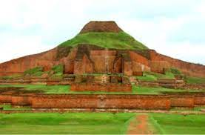
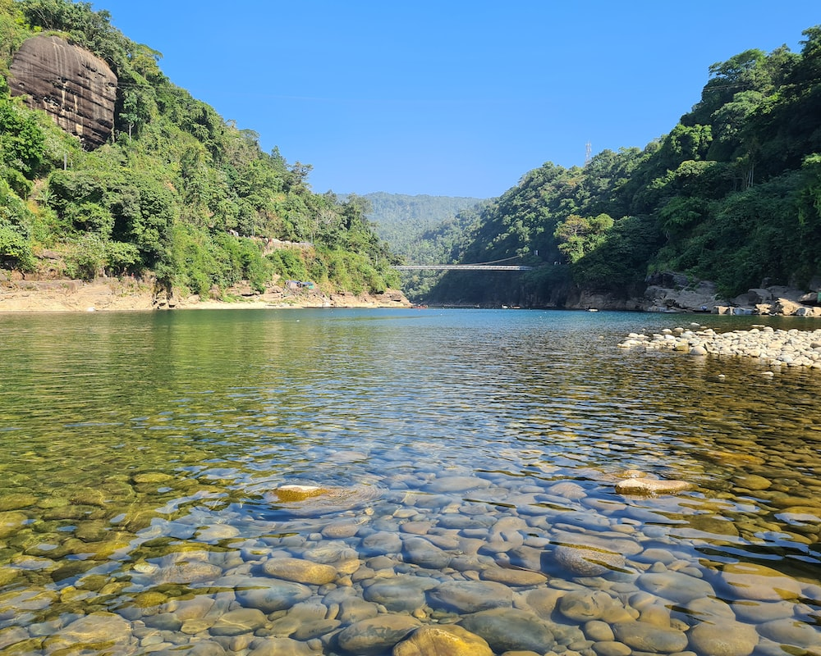
Tourist Spots
Mahasthangarh
Cox's Bazar
Jaflong
05

Slide 7
Features
Make life easier for travelers Popularity shows of resort Improved authentication and security Improved business Suitable location to visits Build up a community for travelers Integration with Hotel/Travel agencies.
06

Slide 8




Frontend Technology
07

Slide 9

Backend Technology
08

Slide 10

Database Technology
09

Slide 11
Methodology
Step-1: Visit our website. Step-2: Select division from the list of Division section. Step-3: Open a new web page which shows district list for selected division then select district. Step-4: Open a new web page which shows the list of Tour Spot for selected district. Then one can select his/her interested place/resort. And know about history of the place (details) and location from Google Maps. Step-5: Register or Login his/her account. Step-6: Select any resort for his/her visited (if he/she visited the place) section or interested (if want to visit the place) section. Step-7: If want, one can post in our website’s community section. And can comment other’s posts.
10

Slide 12
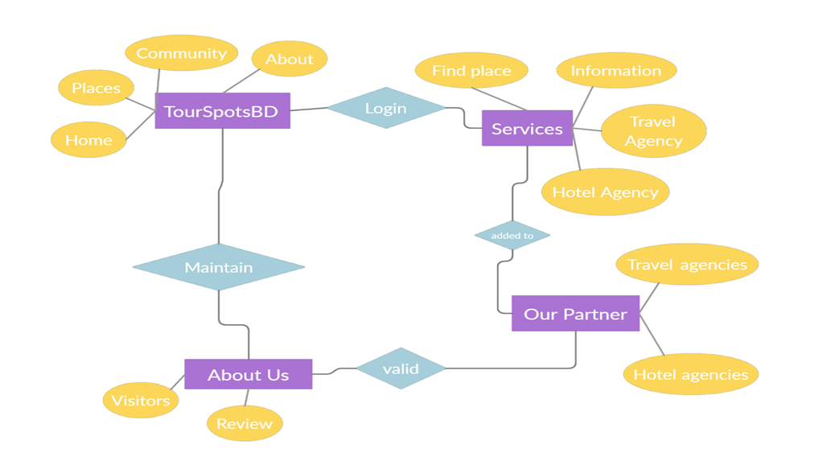
Project Layout
Figure 01: Project Layout
11

Slide 13
Use Case Diagram
ATS Bangladesh
HOME
DATABASE
PLACES
<<includes>>
SEARCH
COMMUNITY
ABOUT
User/Visitor
<<includes>>
<<includes>>
Administrator
LOGIN
REGISTER
HELP CENTER
Figure 02 : Use Case Diagram for ATS Bangladesh
12

Slide 14
UML Diagram
-User Details
-Place Details
All Tour_Spot BD
*……*
1……*
Division
-Division Name: char
-Division Details: string
user
-Name : char
-Email : char
-Password : string
*……*
*……1
+select Division()
+Sign up()
+login()
1……*
1……*
Place
*……1
Favourite Place
-Place Name: string
-Place Address: string
-place Location on Map
-Favourite_Place Name: char
-Favourite_Place Address: char
*……*
*……*
+select Division()
+Select Favourite place()
Figure 03 : UML Diagram
13

Slide 15
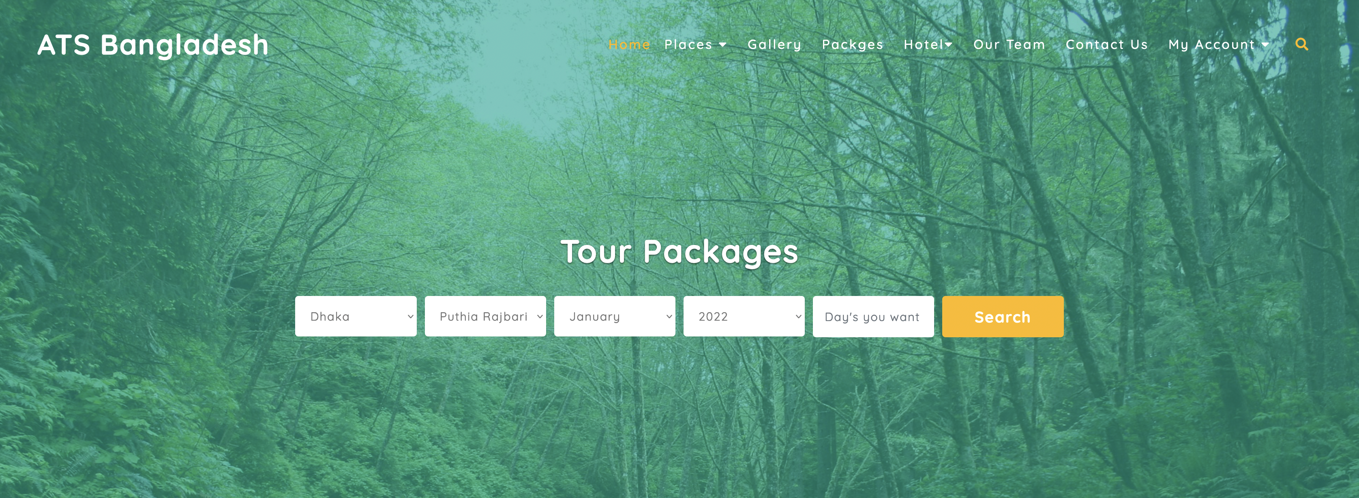
User Interface Snapshot
Figure 04 : Header of Home Page
14

Slide 16
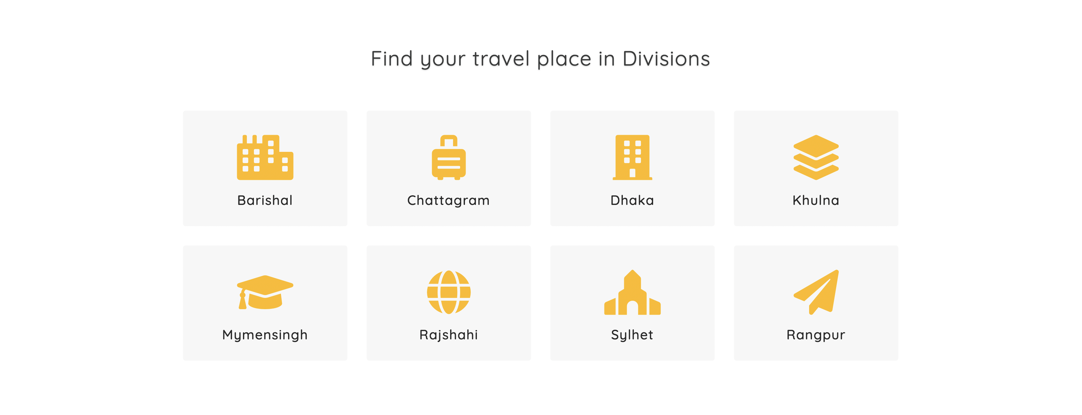
Figure 05 : Search travel place in Division
15

Slide 17
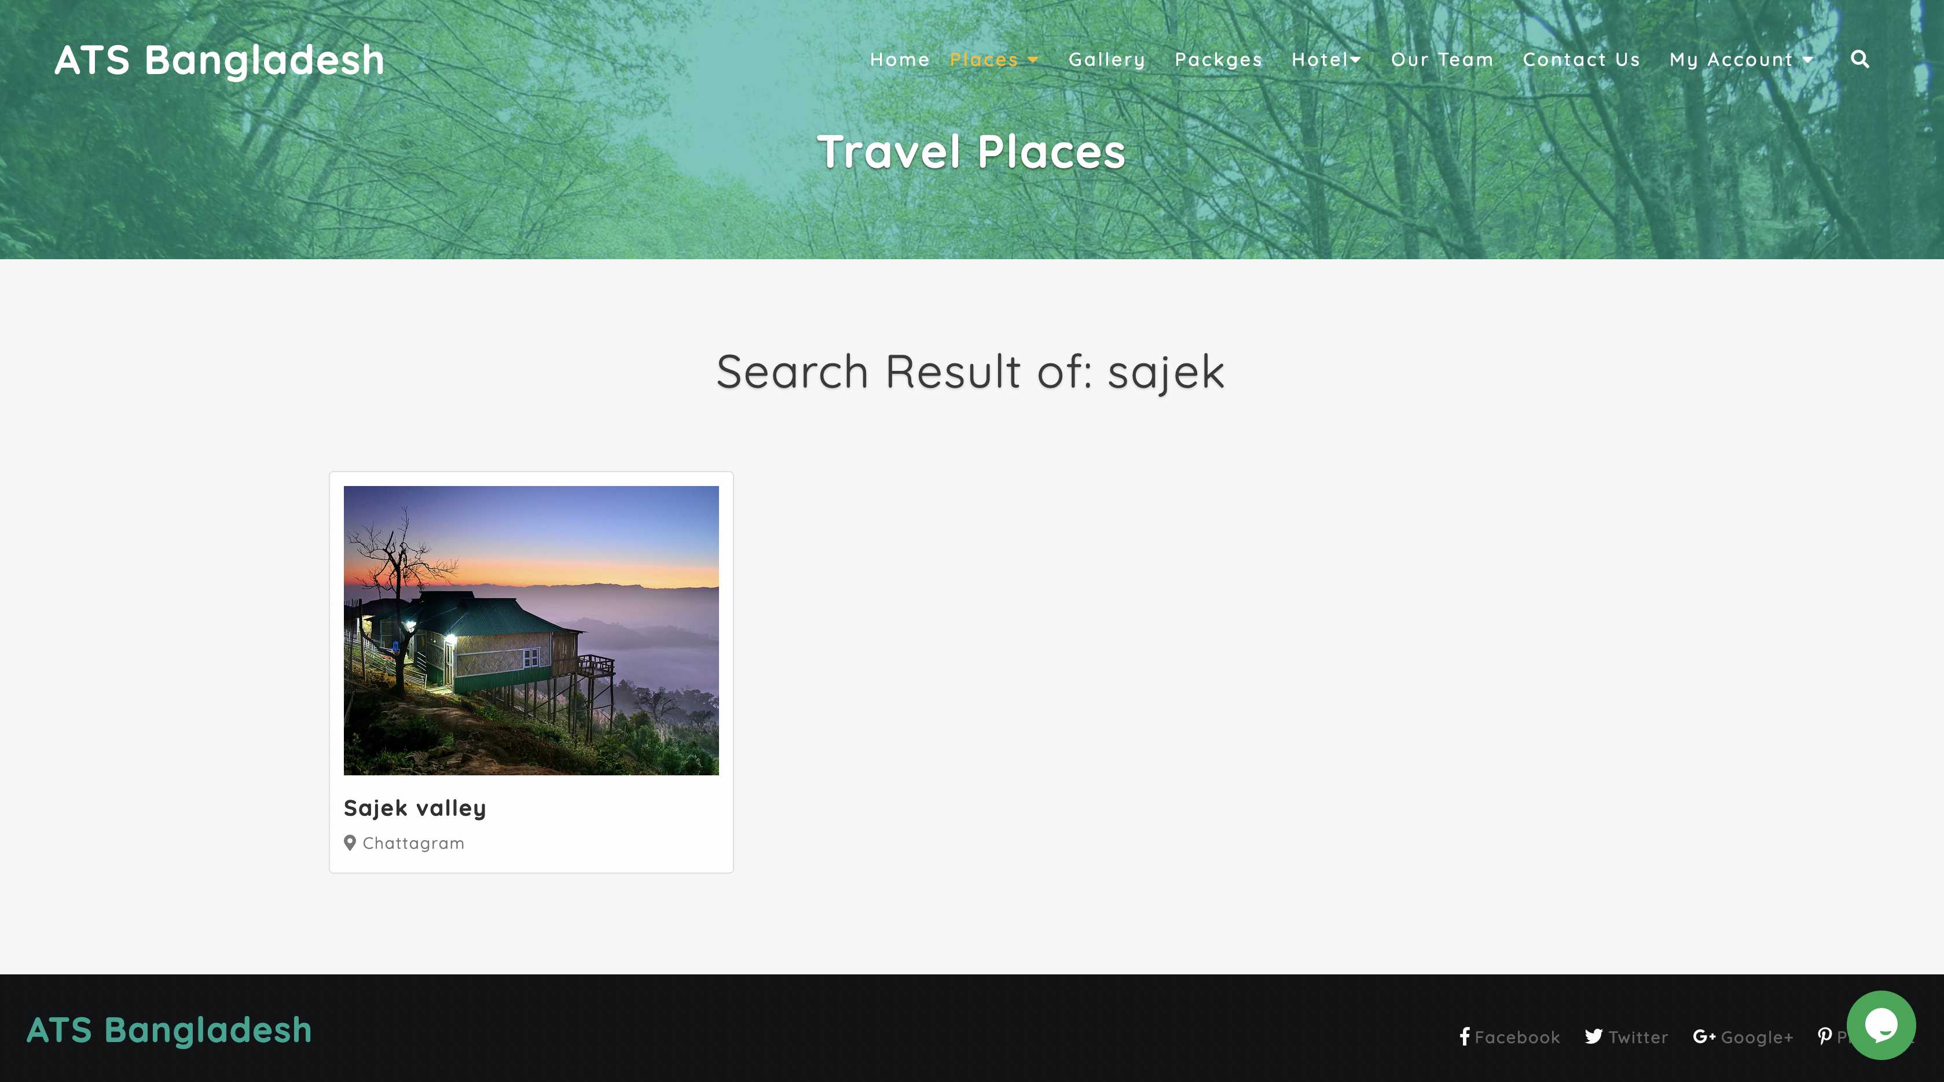
Figure 06 : Search_travel_place_by_typing_name
16

Slide 18
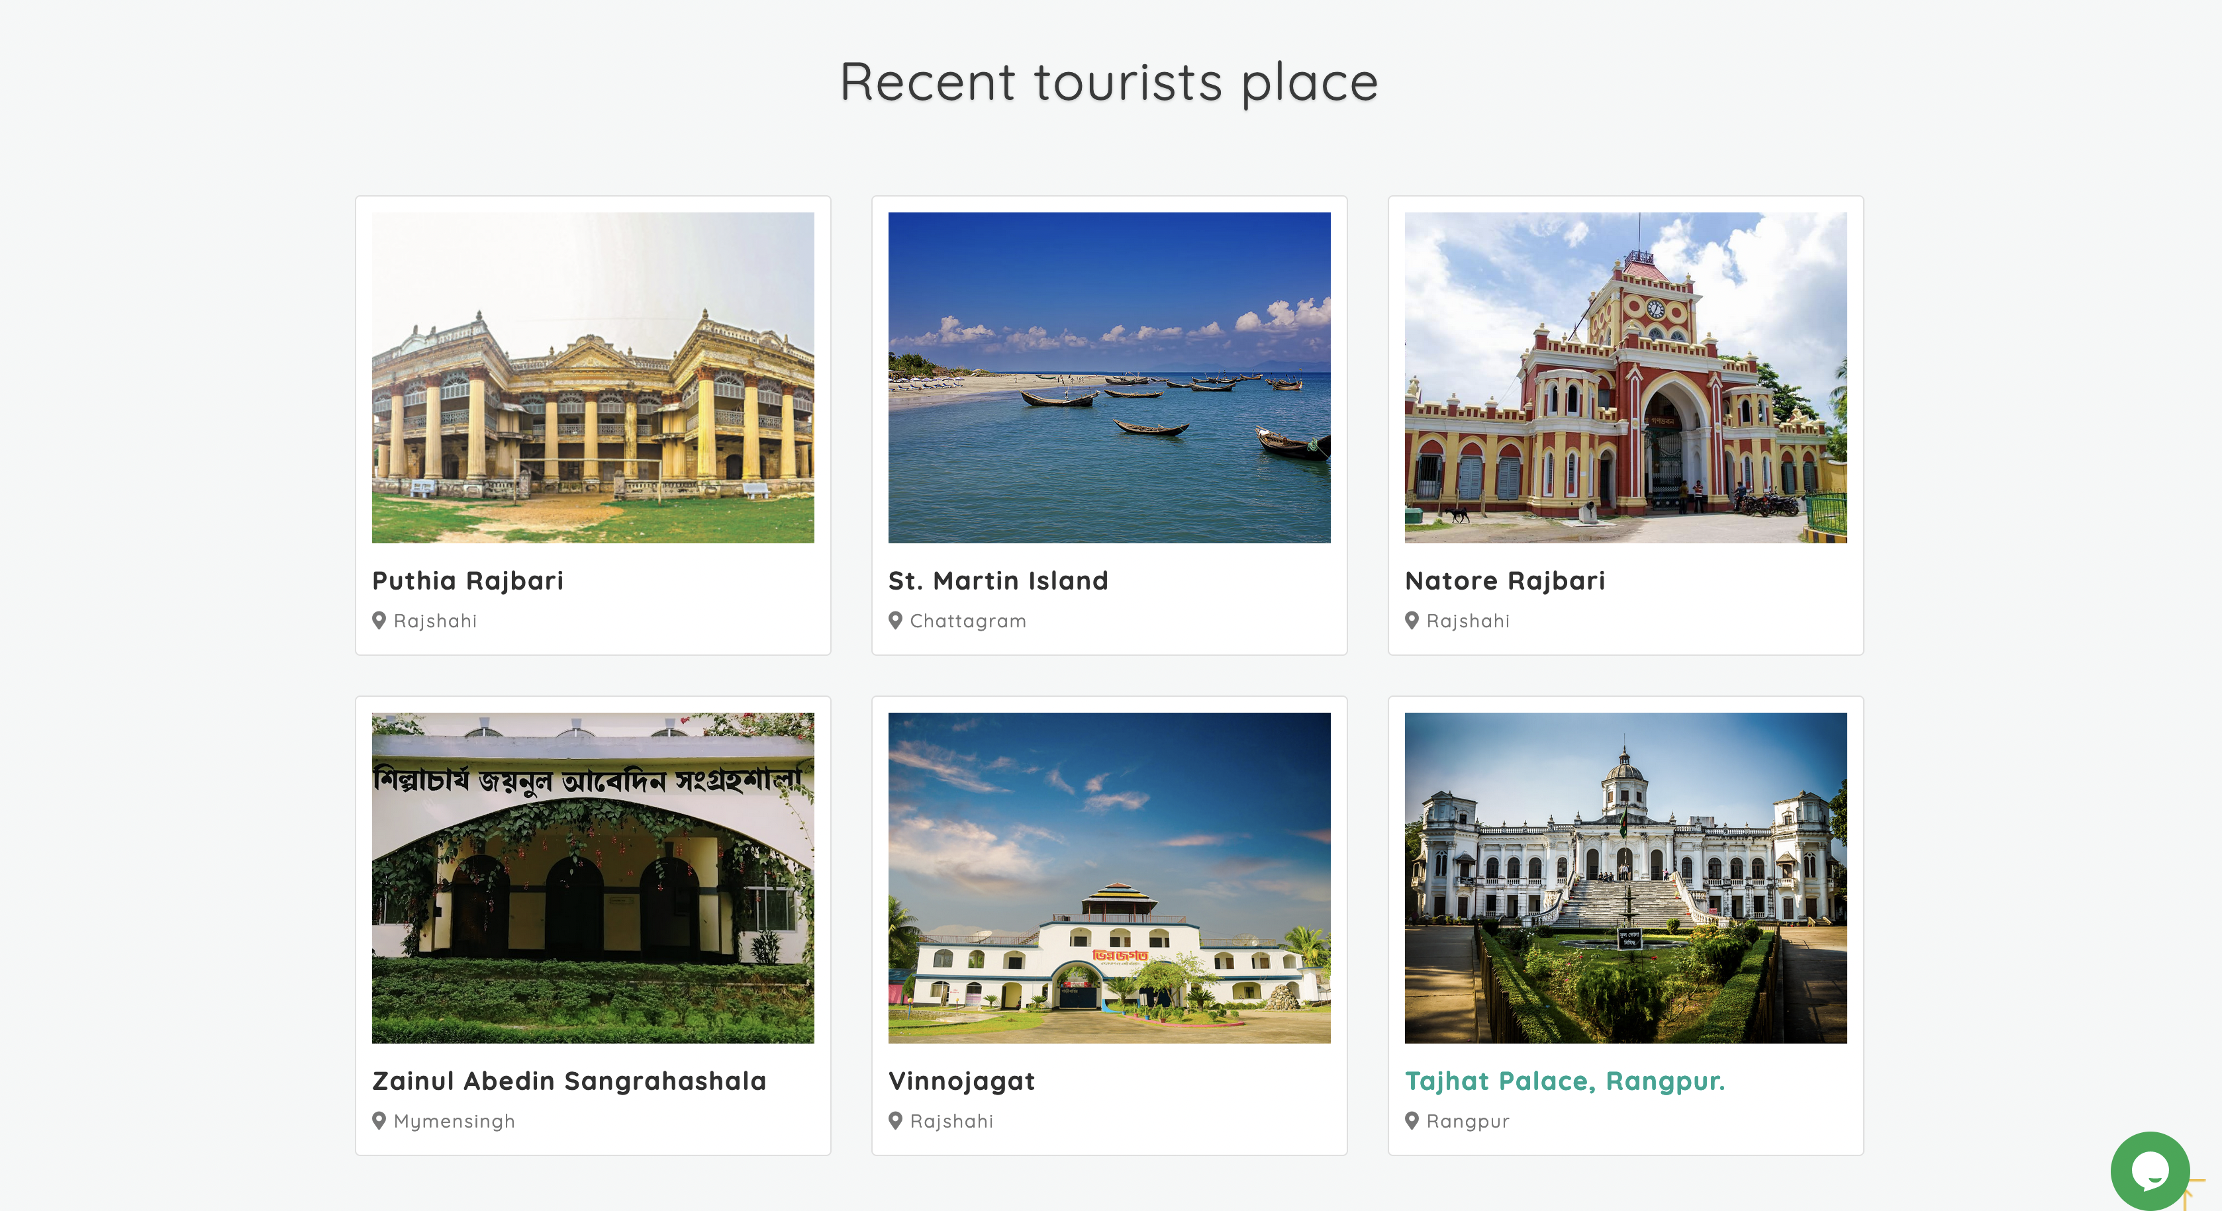
Figure 07 : Recent Tourist place
17

Slide 19
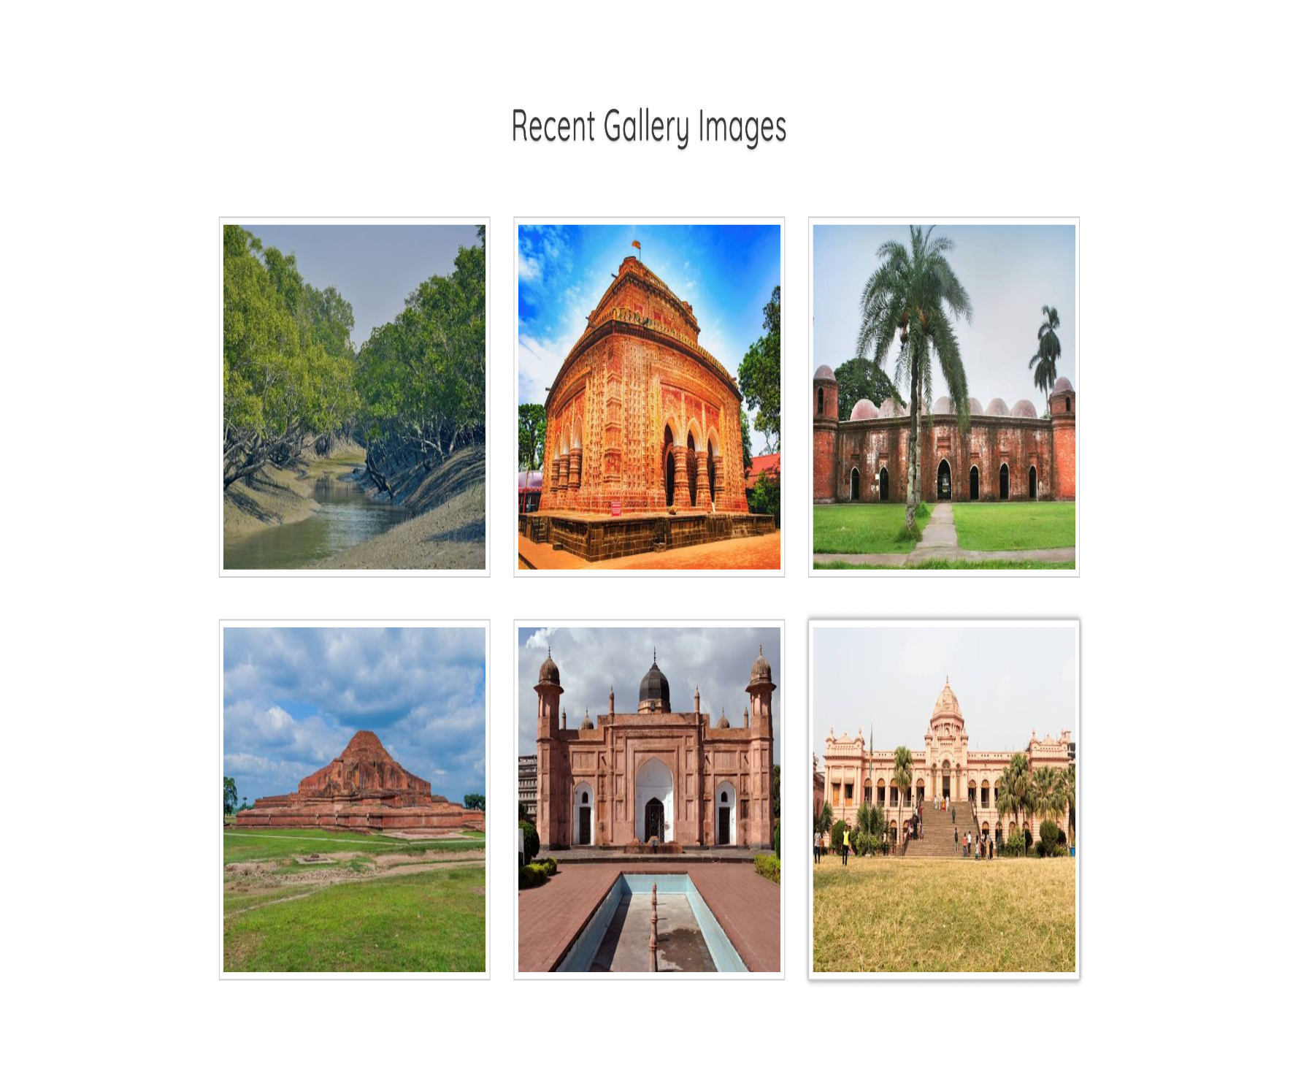
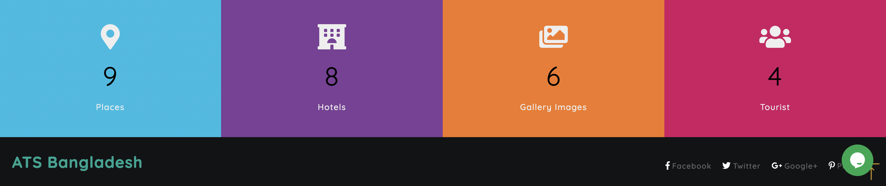
Figure 09 : Footer of Home Page
Figure 08 : Recent Gallery Images
18

Slide 20
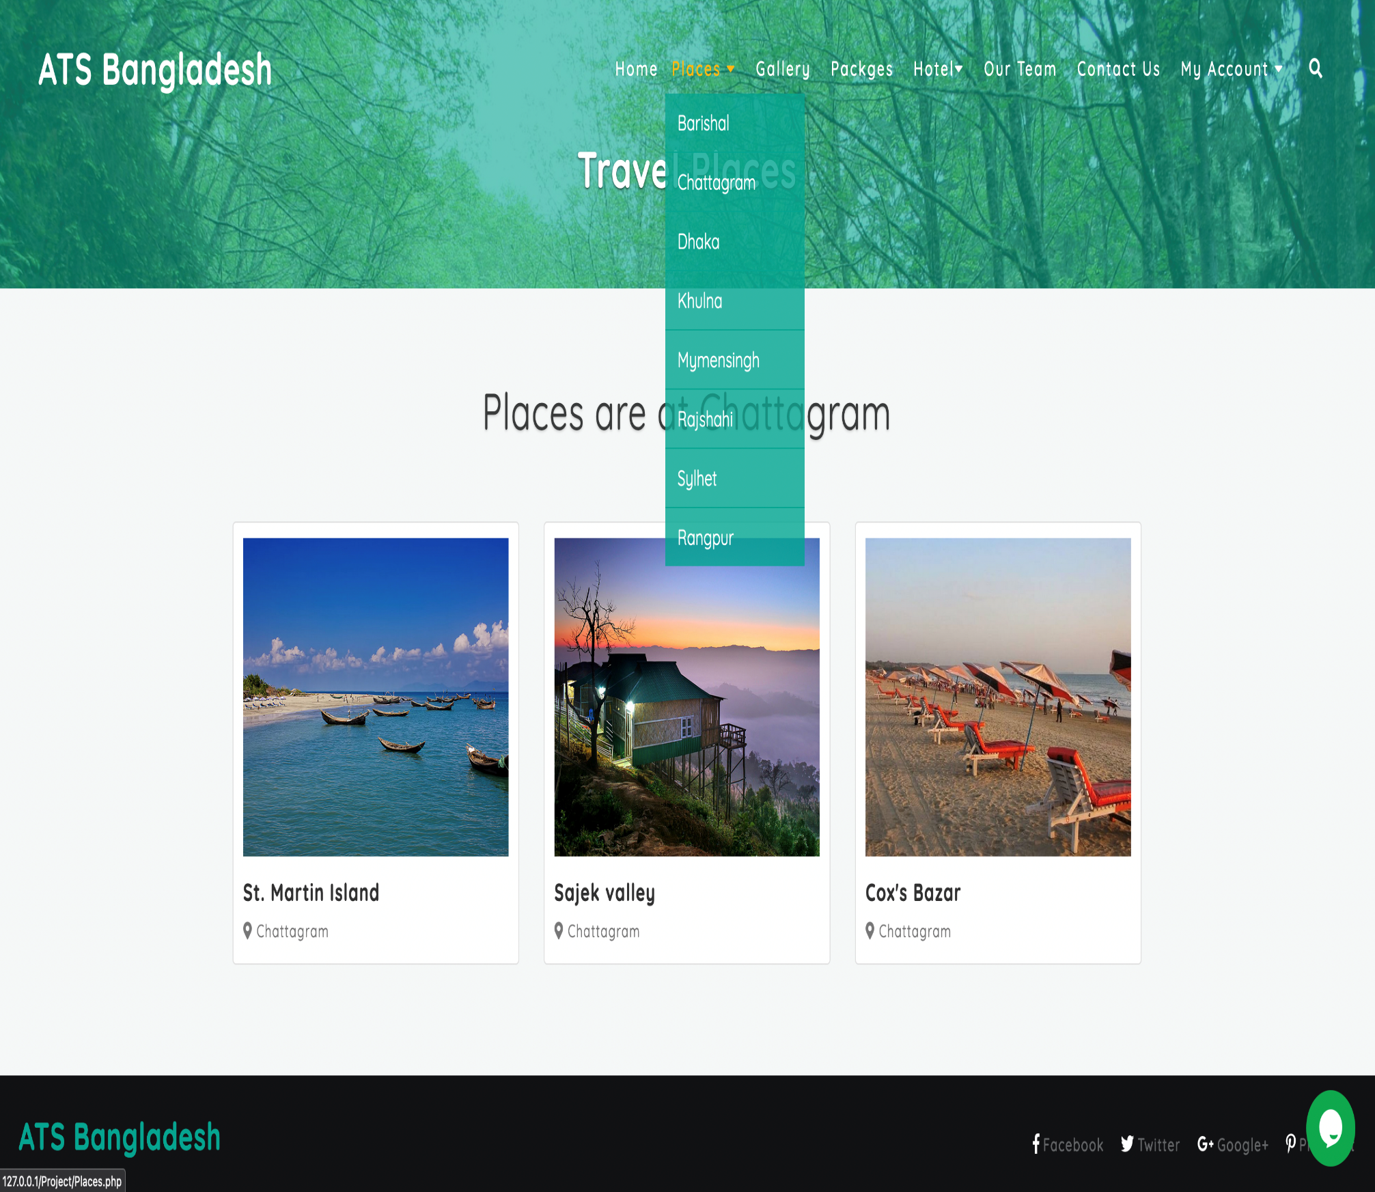
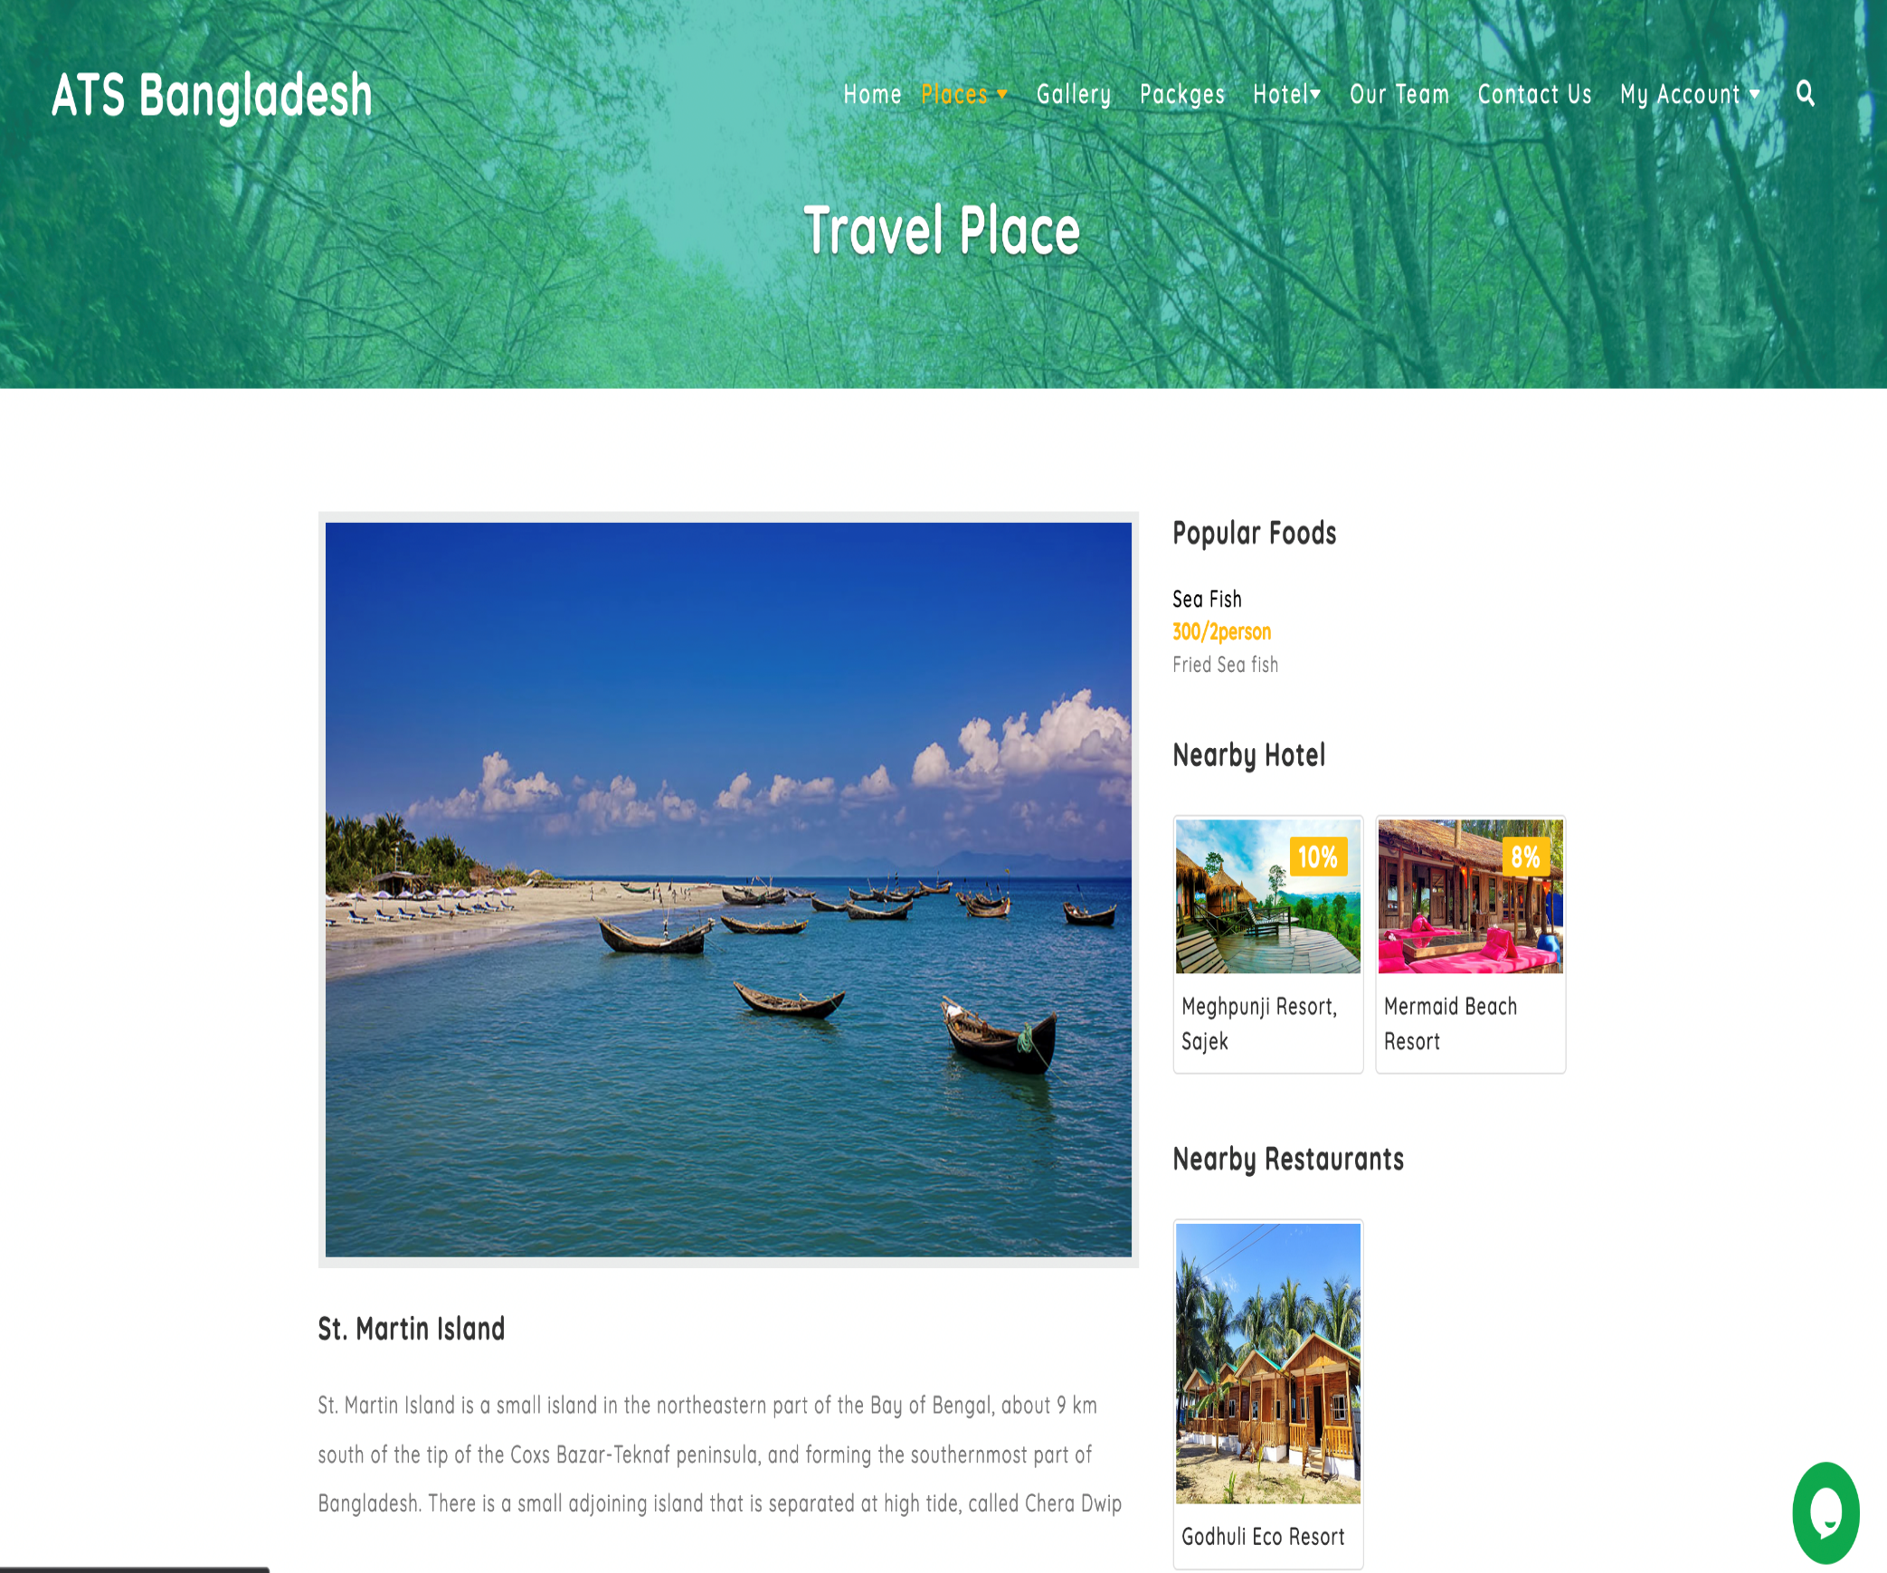
Figure 10 : Sorting Travel Place by Division
Figure 11 : Demo of a Travel Place (St Martin Island)
19

Slide 21
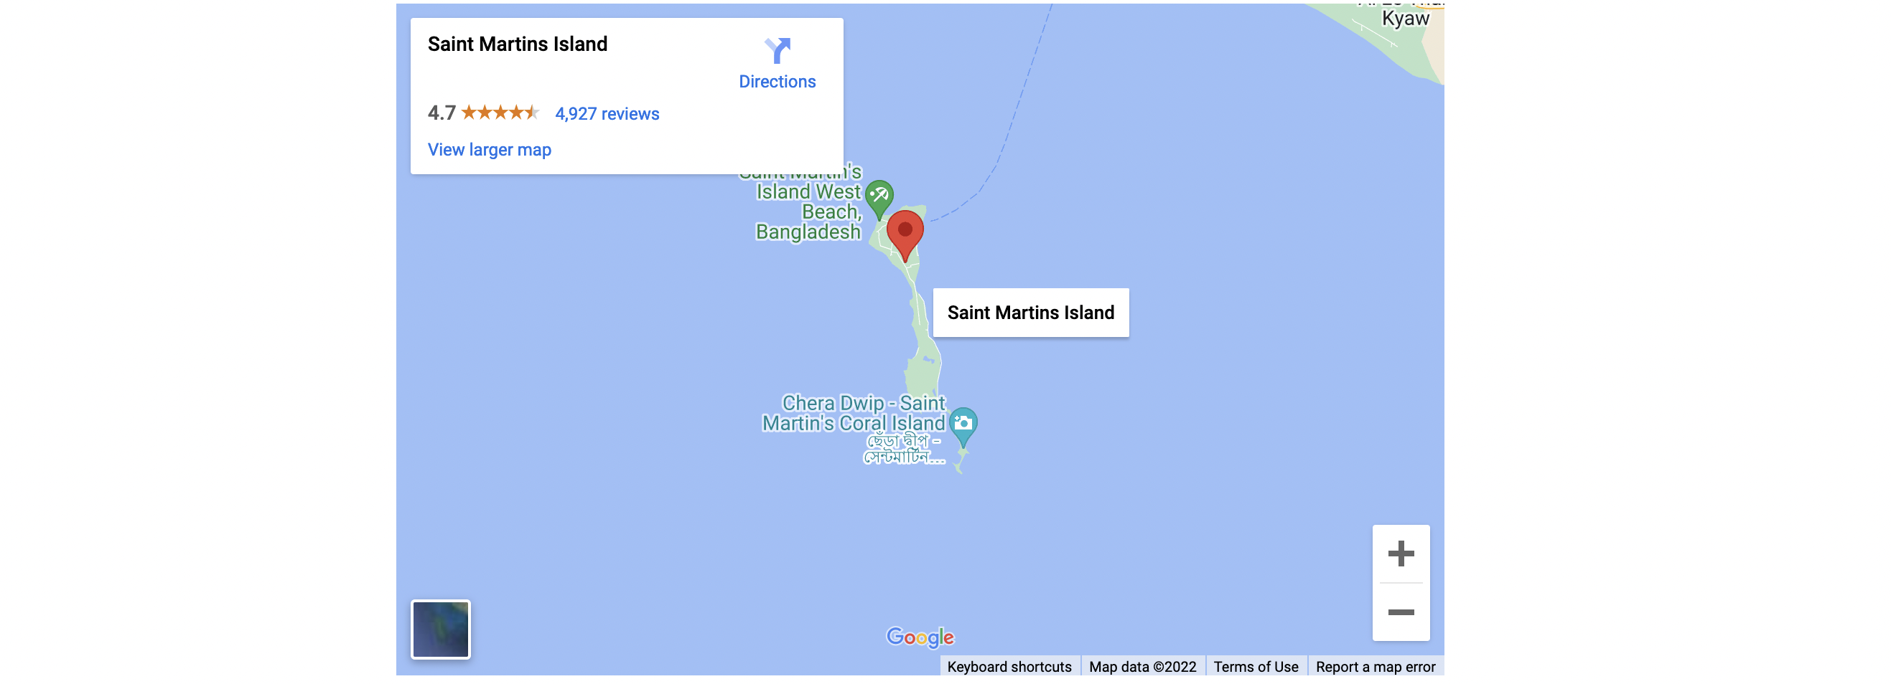
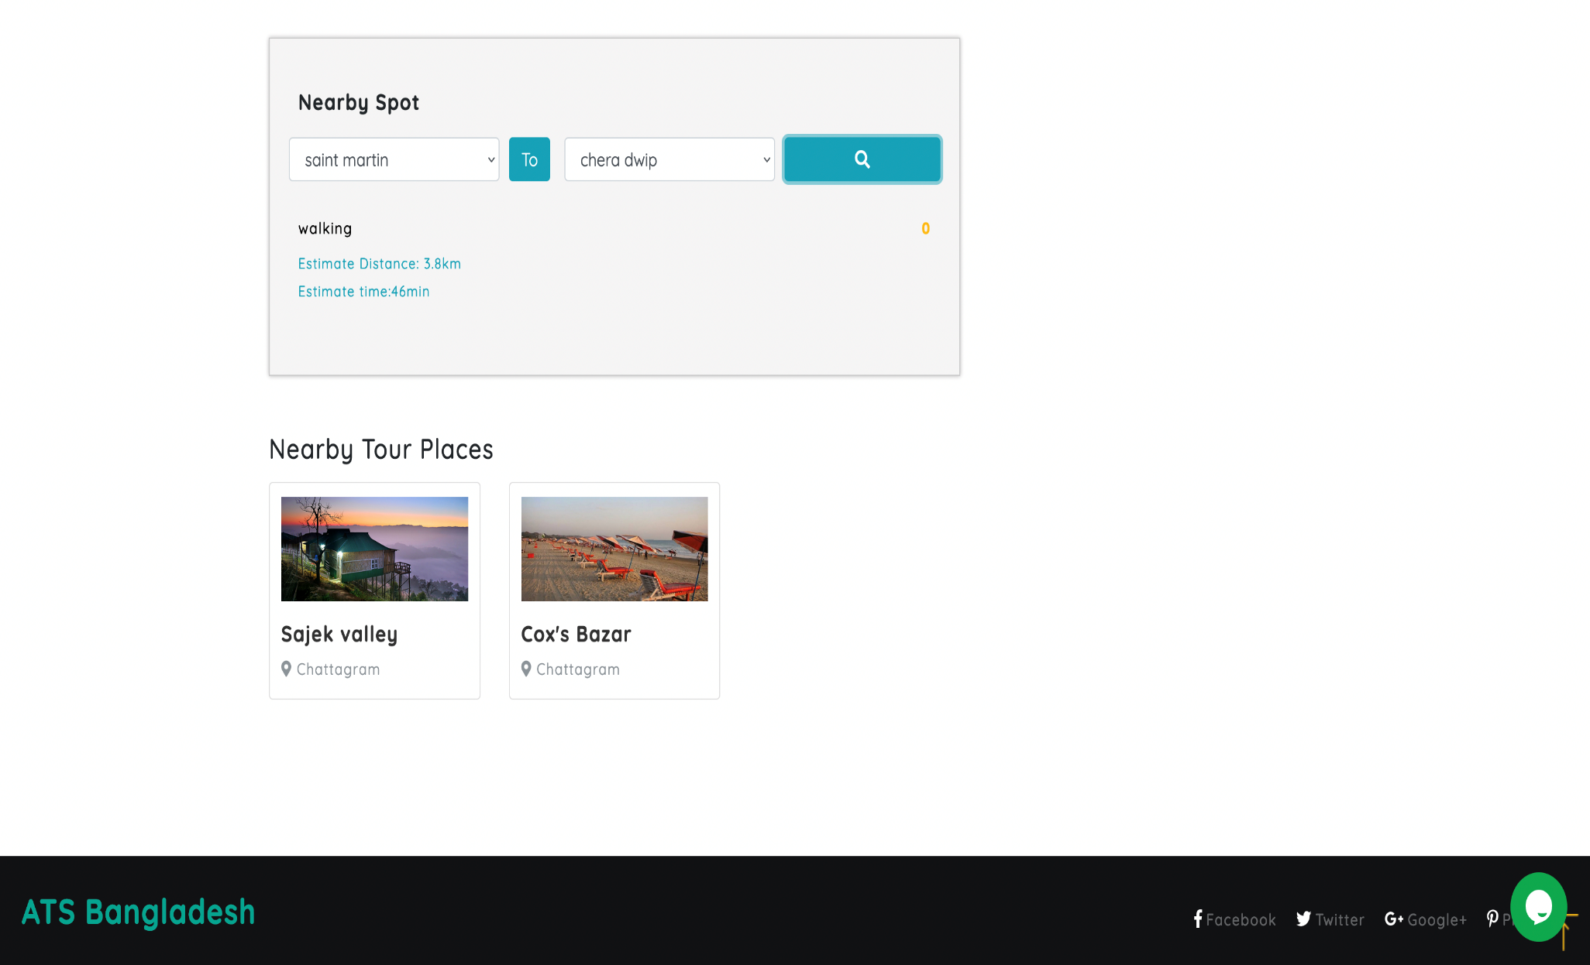
Figure 12 : Location of St Martin Island Using GMAPS API
Figure 13 : Footer of Travel Place
20

Slide 22
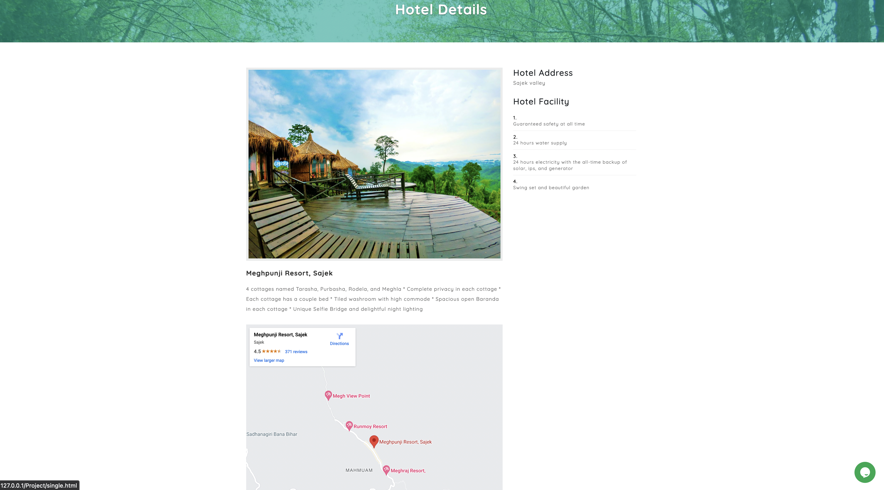
Figure 14 : Demo of hotel Details (Meghpunji Resort)
21

Slide 23
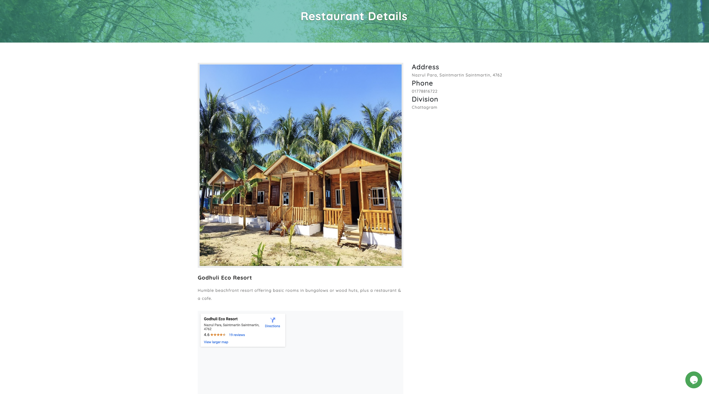
Figure 15 : Demo of a Restaurant (Godhuli Eco)
22

Slide 24
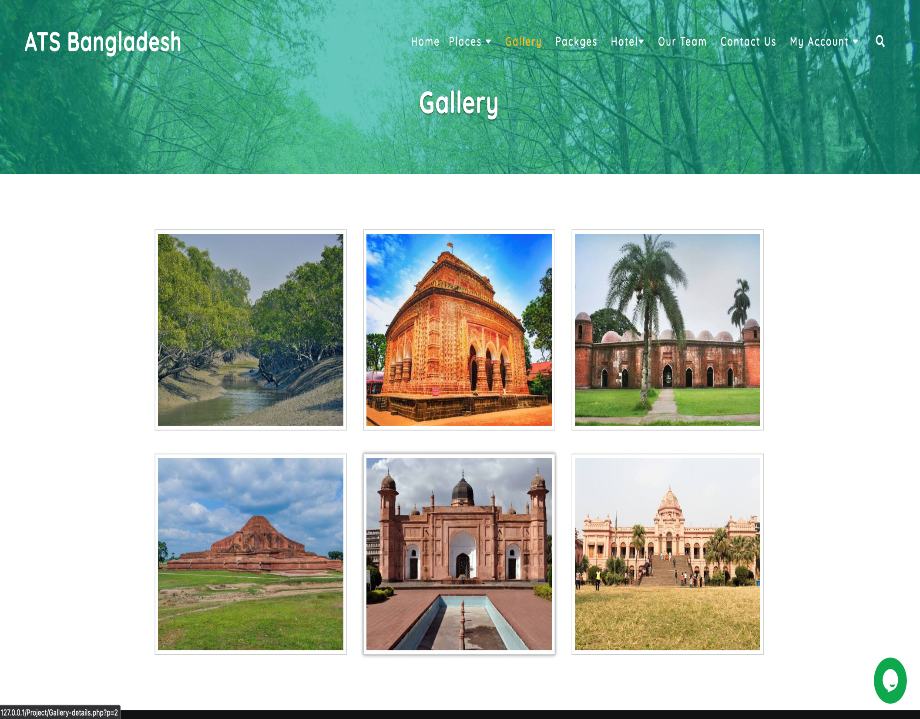
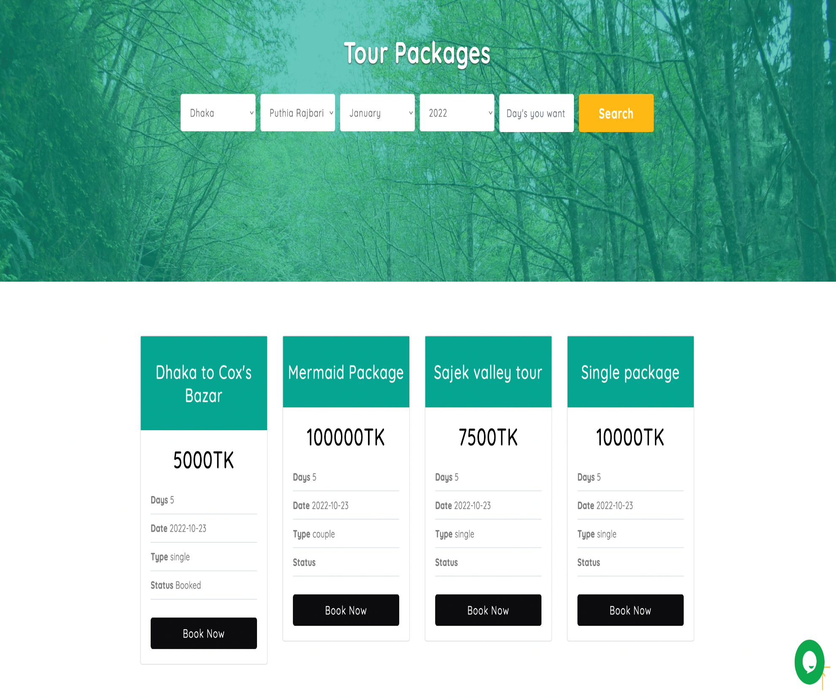
Figure 16 : Gallery
Figure 17: Tour Packages
23

Slide 25
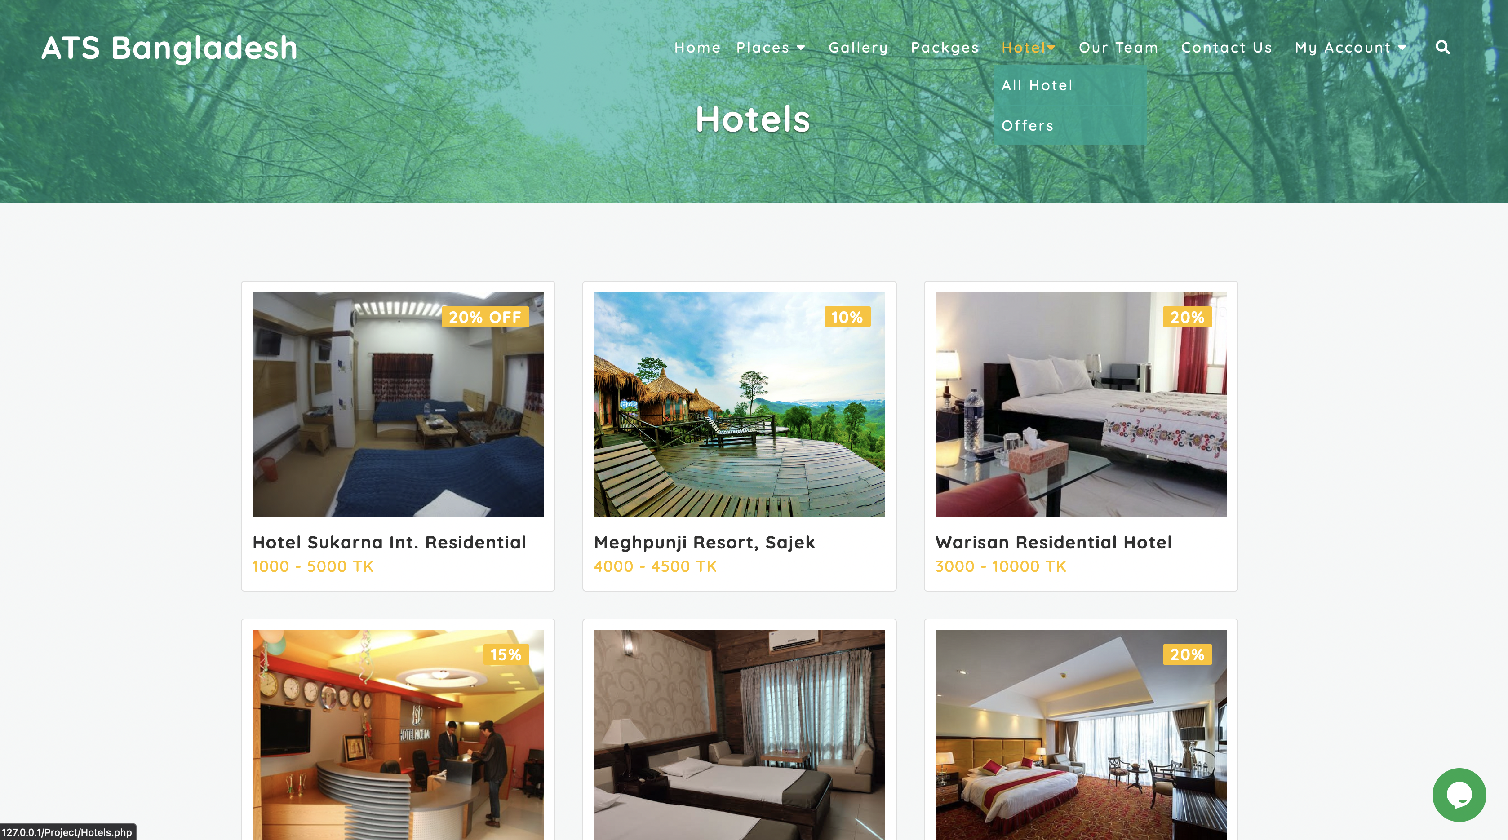
Figure 18 : Hotels
24

Slide 26
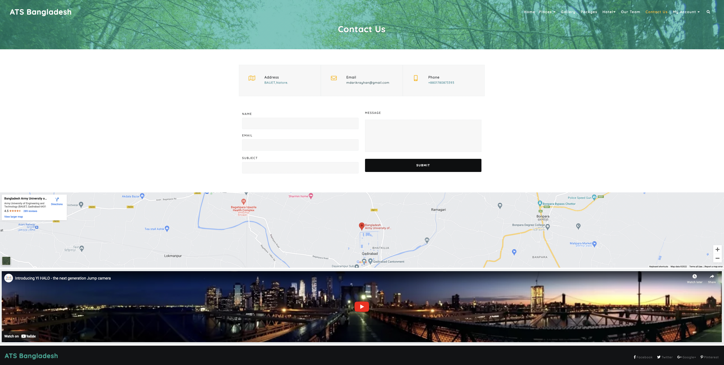
Figure 19 : Contact Us and Demo AR/VR
26

Slide 27
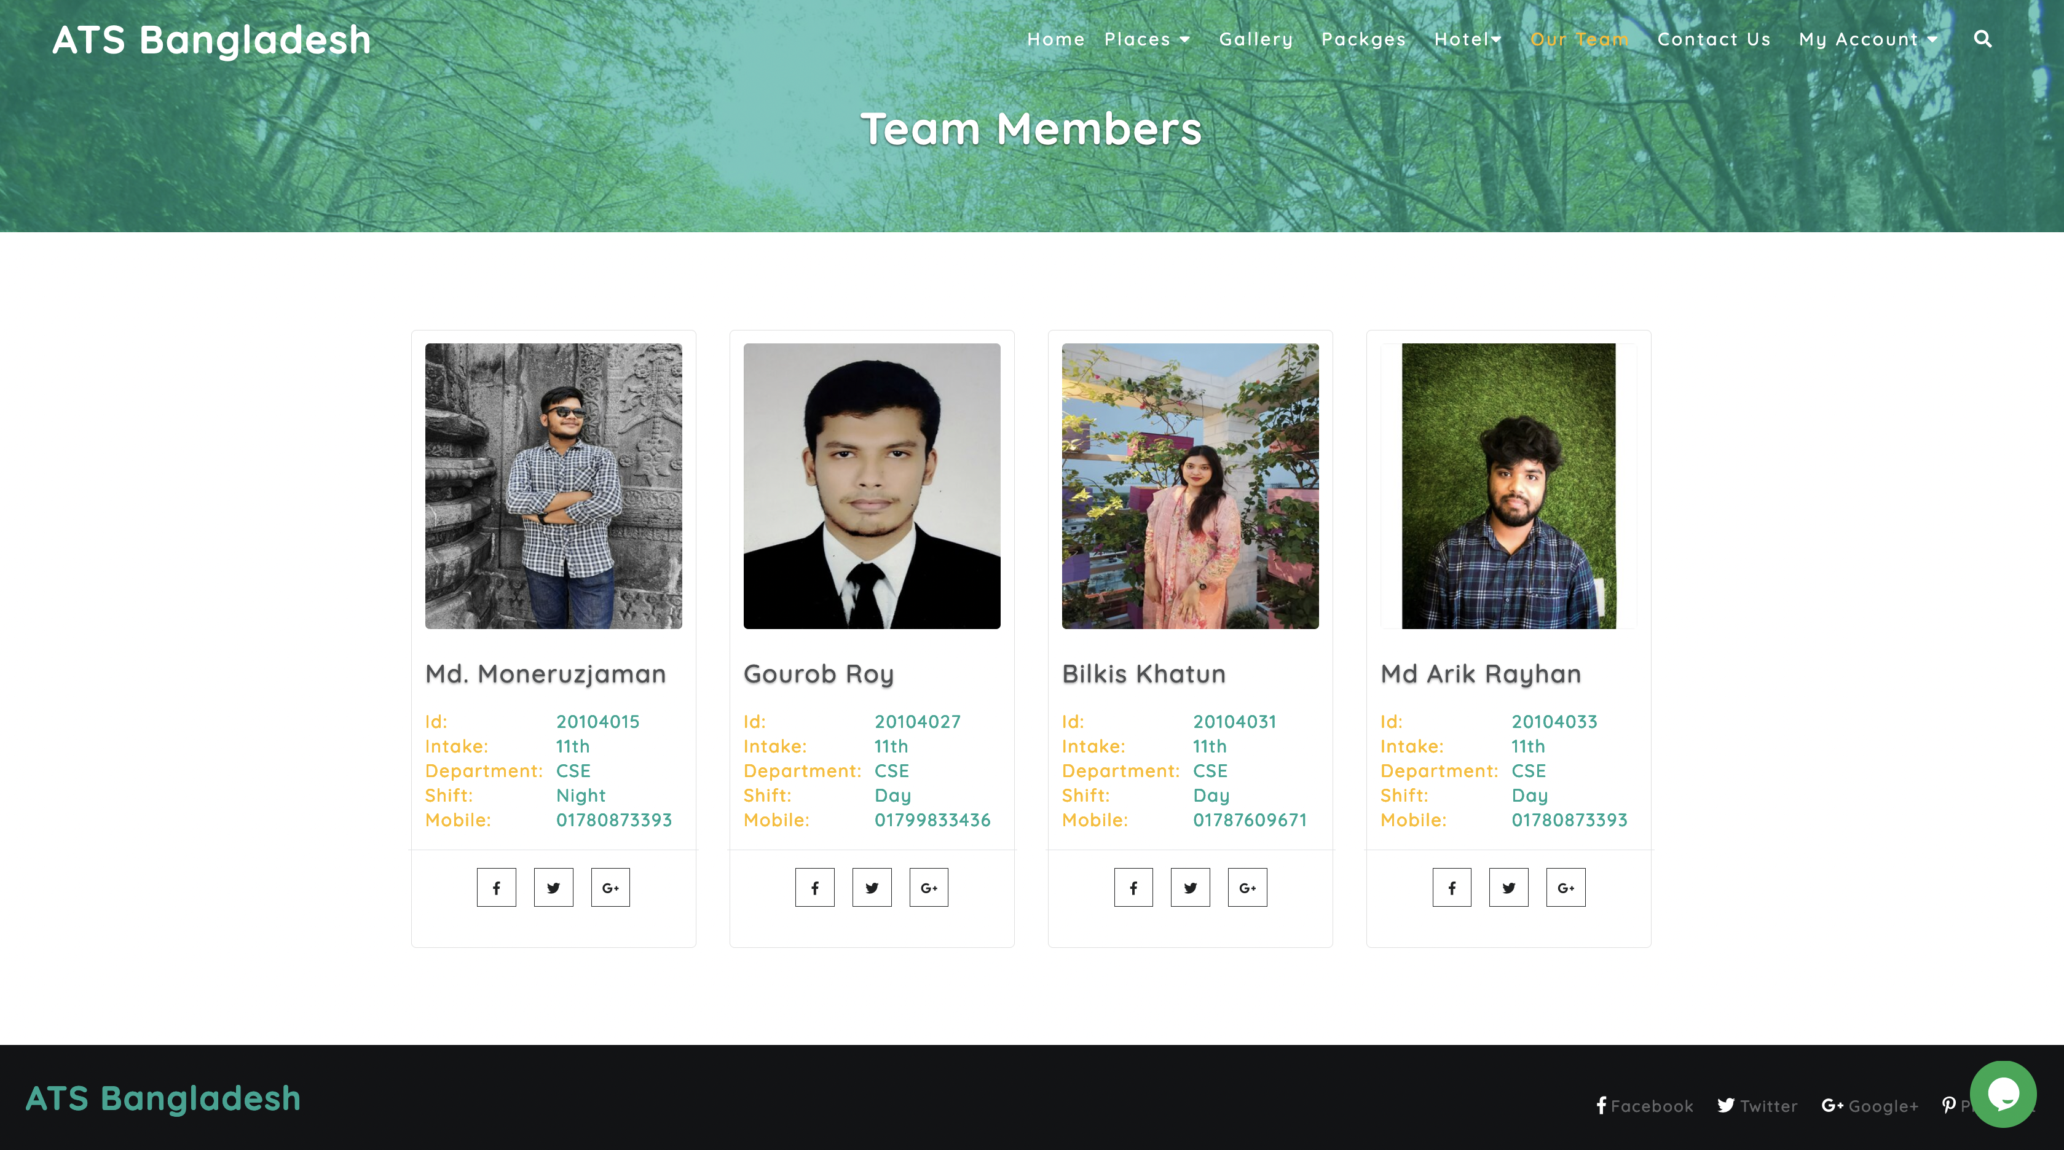
Figure 20 : About Us
25

Slide 28
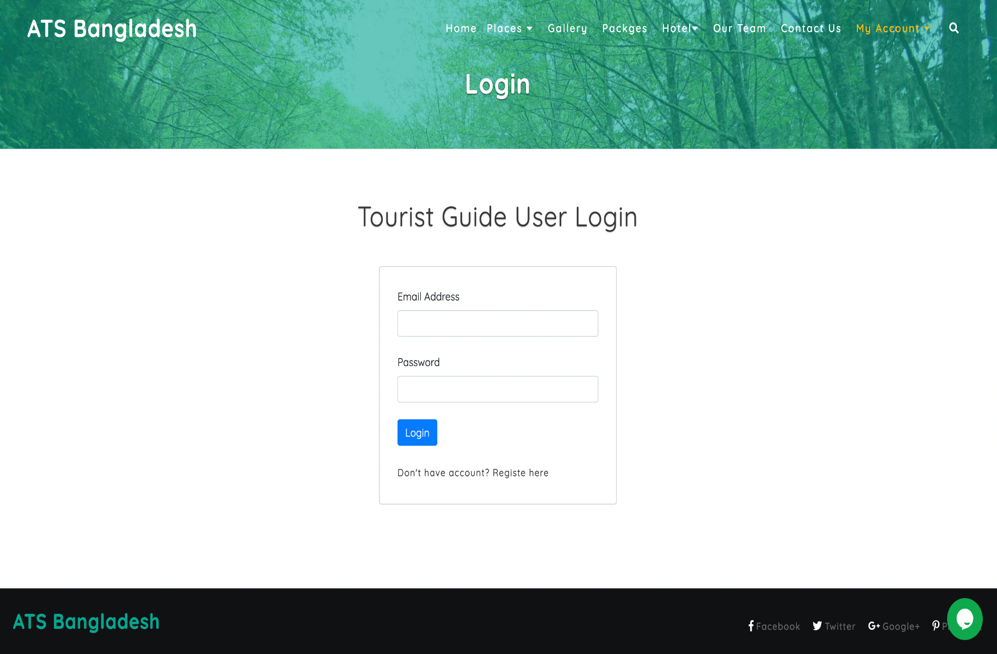
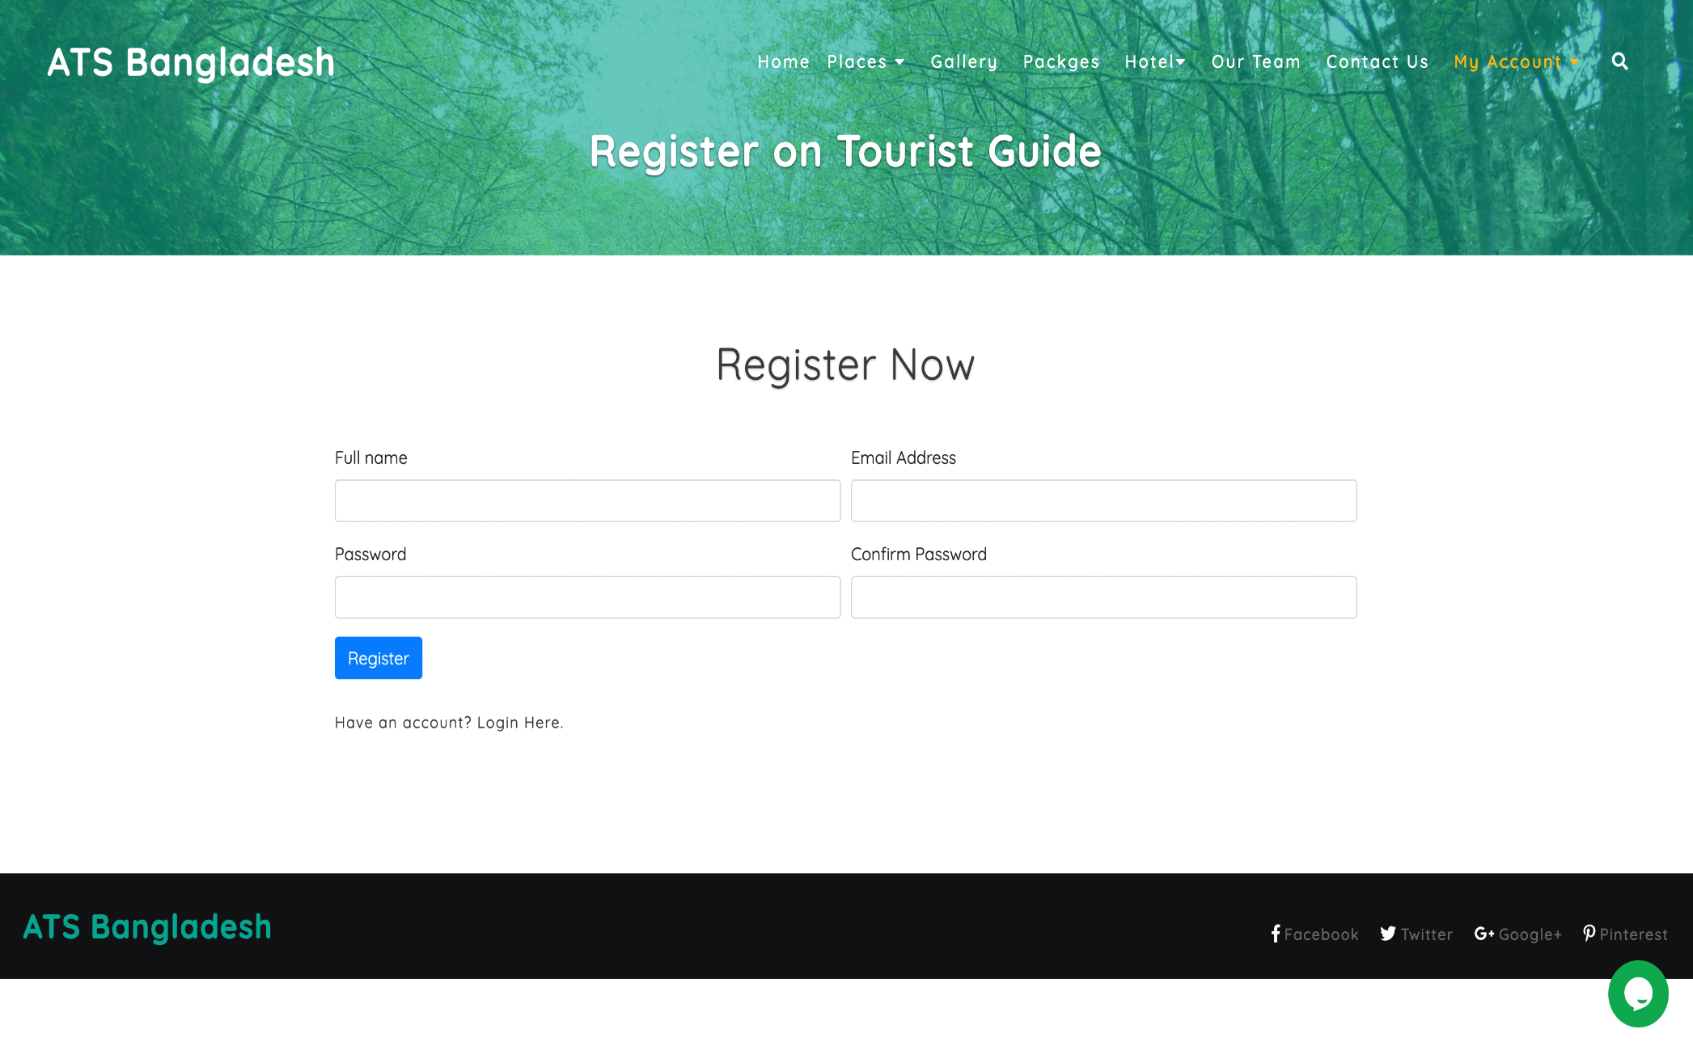
Figure 21 : Login Page
Figure 22 : Registration Page
27

Slide 29
Advantage
One can easily find out the tour spot according to division or district wise. Anyone all over the world can visit the website and know about tour spot in Bangladesh. Registered users can write posts in our community section. Users also can react to other’s posts. Visitors will get information about how to go to his/her selected tour spot and what kind of transport is required. This information provides our travel agencies partner. If anyone wants to know the information of any residential or non-residential hotel in the vicinity (nearest) of the tour spot, they will get this information from our website.
28

Slide 30
Conclusion
The website will have a list of all the “Tour Spots” in Bangladesh. Tour spots will be sorted by district-wise. Users (or visitors) will be able to find out details about the ‘tour spot’ and see the location of the tour spot through Google Maps. This website will have a community section where users can share their travel experiences. If you want to visit a place, then you can share everything in the community section if you want. Users will be able to give ratings and reviews on each of the tour spot shown on the website.
29

Slide 31

Any Question?

Slide 32


